Slide 1



Global challenges and Internships
Peter Murray-Rust
Department of Chemistry, Cambridge
Shweata N. Hegde
Project Manager (TIGR2ESS)

Slide 2
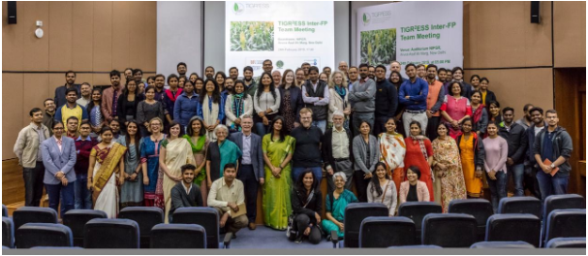
TIGR2ESS Workshop 2019, New Delhi
Intern-based 2 months online prep.
1-day knowledge-mining workshop
Peter Murray-Rust and Interns

Slide 3
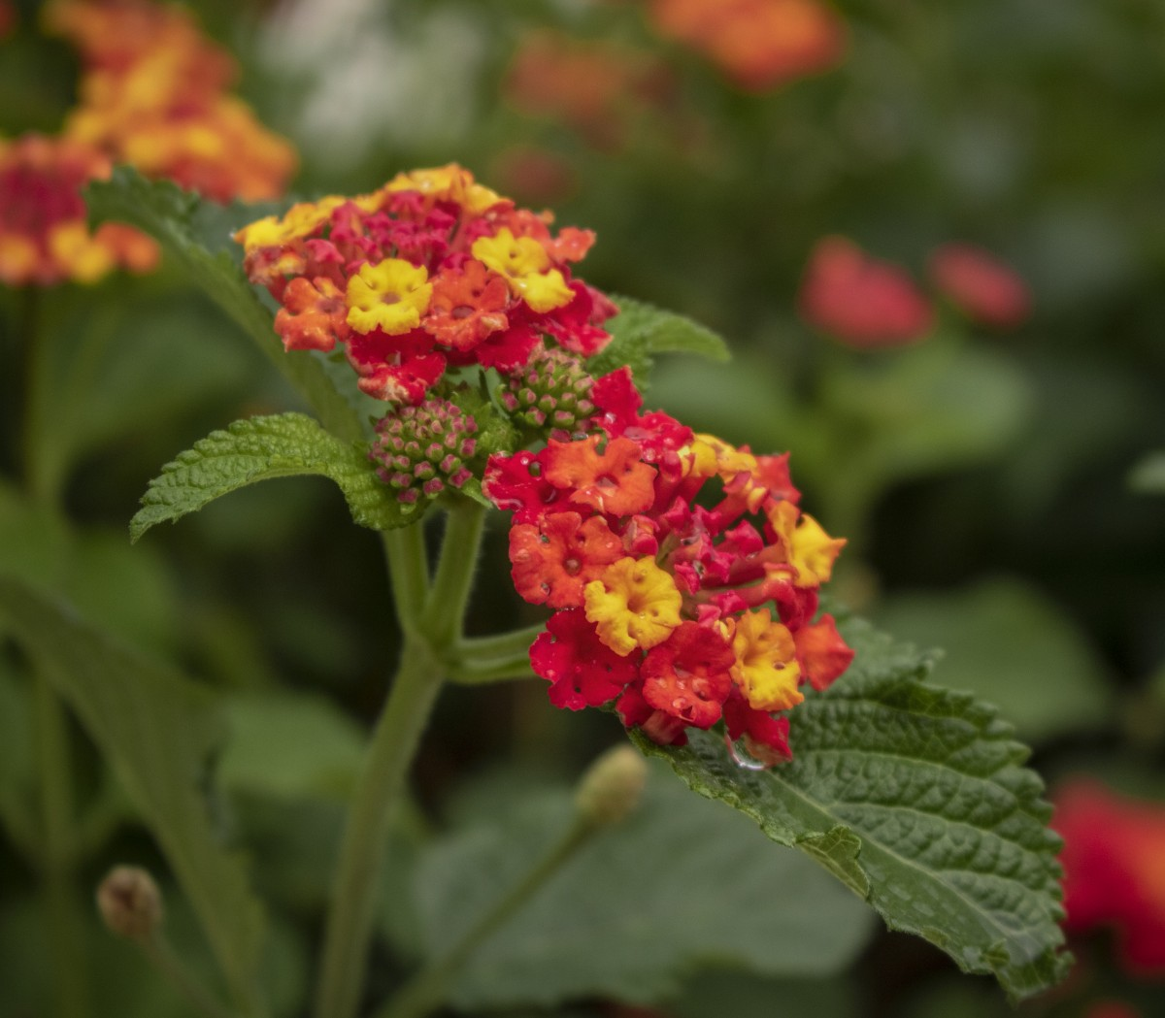
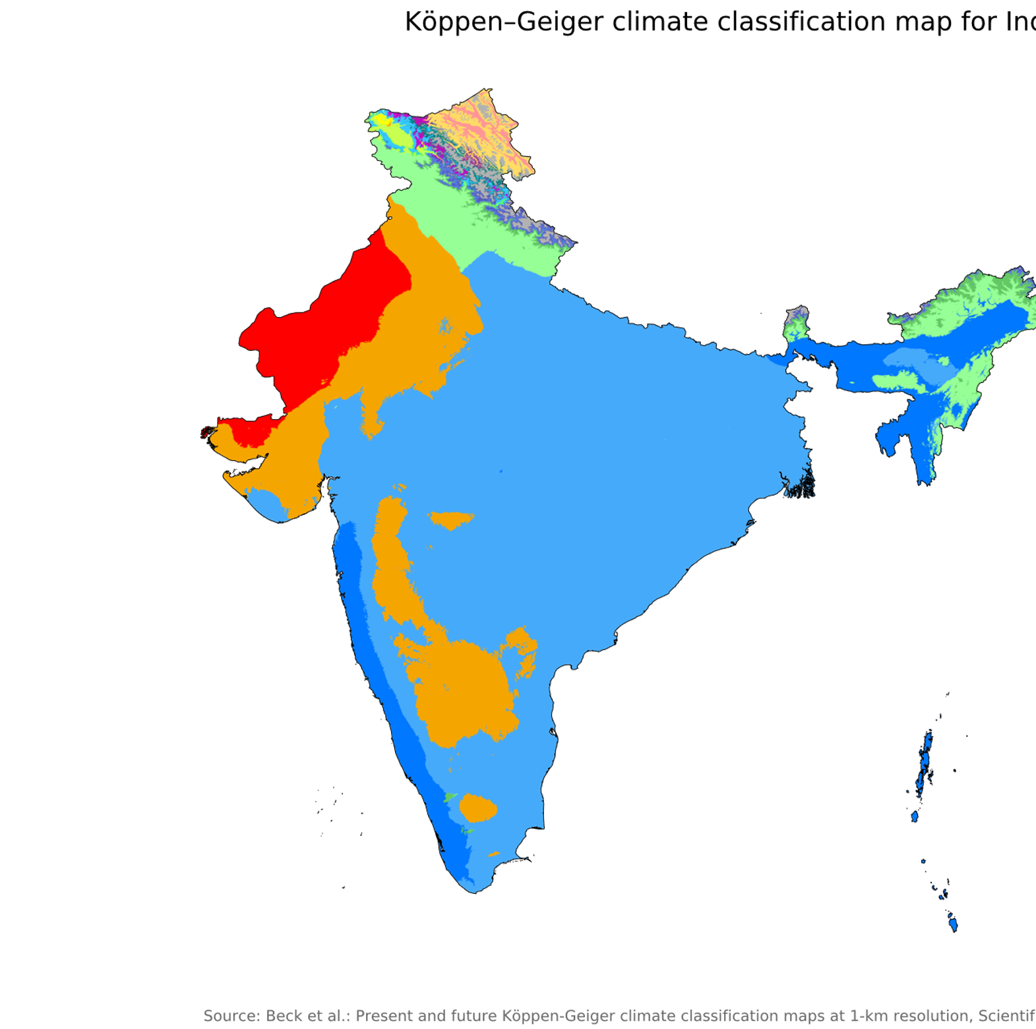
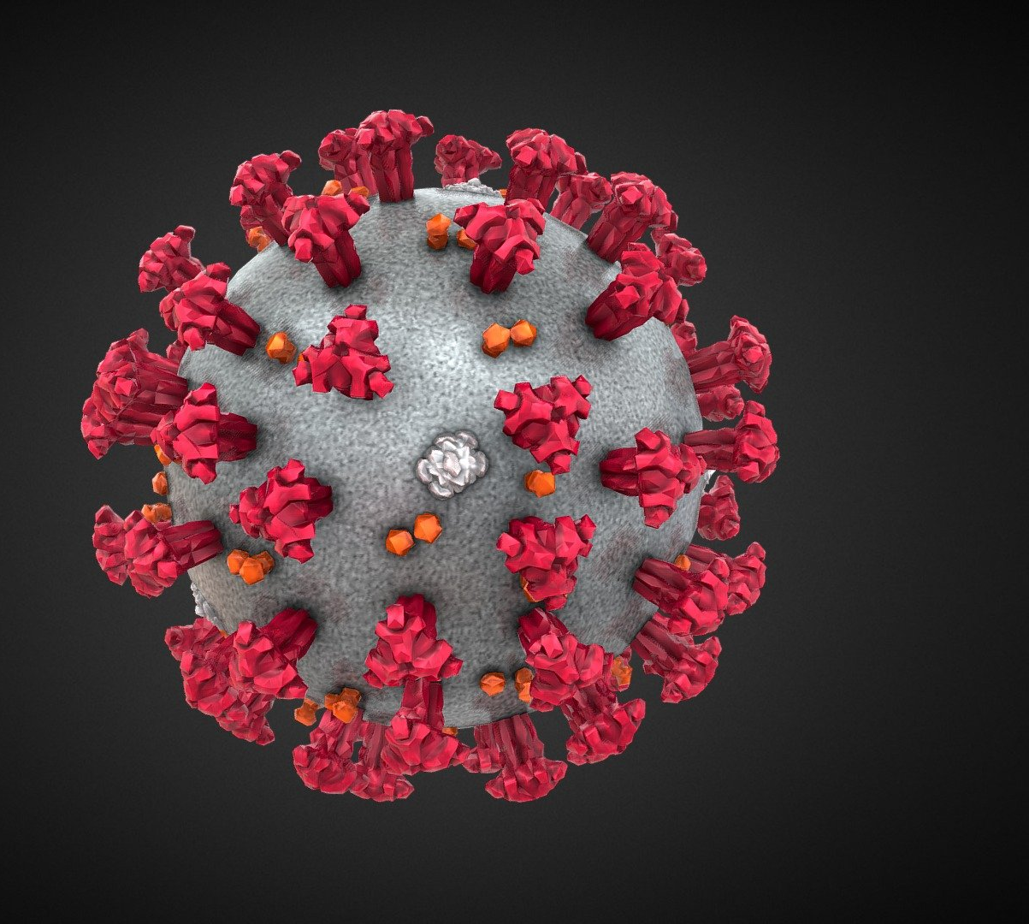
2020
2021
2022
openVirus
Invasive species
IPCC reports
By Beck, H.E., Zimmermann, N. E., McVicar, T. R., Vergopolan, N., Berg, A., &amp; Wood, E. F. - &quot;Present and future Köppen-Geiger climate classification maps at 1-km resolution&quot;. Nature Scientific Data. DOI:10.1038/sdata.2018.214., CC BY 4.0, https://commons.wikimedia.org/w/index.php?curid=74673686
This Photo by Unknown Author is licensed under CC BY

Slide 4

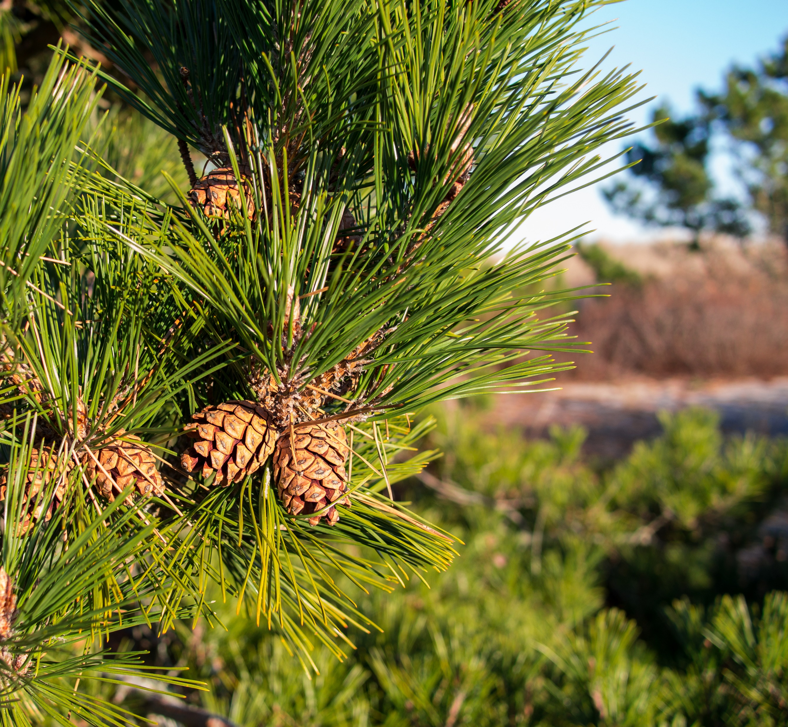
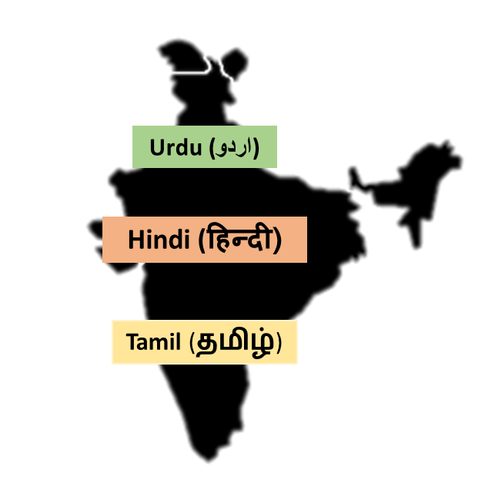


Dictionaries
MULTILINGUAL
Machine-understandable
<synonym xml:lang="zh">松球</synonym>
<synonym xml:lang="de">Koniferenzapfen</synonym>
<synonym xml:lang="hi">कोणधारी कोण</synonym>
<synonym xml:lang="es">cono</synonym>
<synonym xml:lang="fr">cône</synonym>
Plants dictionary
This Photo by Unknown Author is licensed under CC BY-SA
Usable in AI
By Version 1 by Nohat (concept by Paullusmagnus); Wikimedia. - File:Wikipedia-logo.svg as of 14 May 2010T23:16:42, CC BY-SA 3.0, https://en.wikipedia.org/w/index.php?curid=33285413
Slide Credit: Ambreen Hamadani
Notes:
Wikidata and Wikipedia globe
Slide for minicopus
Make it clearer __ explain well
Explain zoonosis
Dictionaries are often called ontology
Critical for annotations and Ontology
Ontology

Slide 5


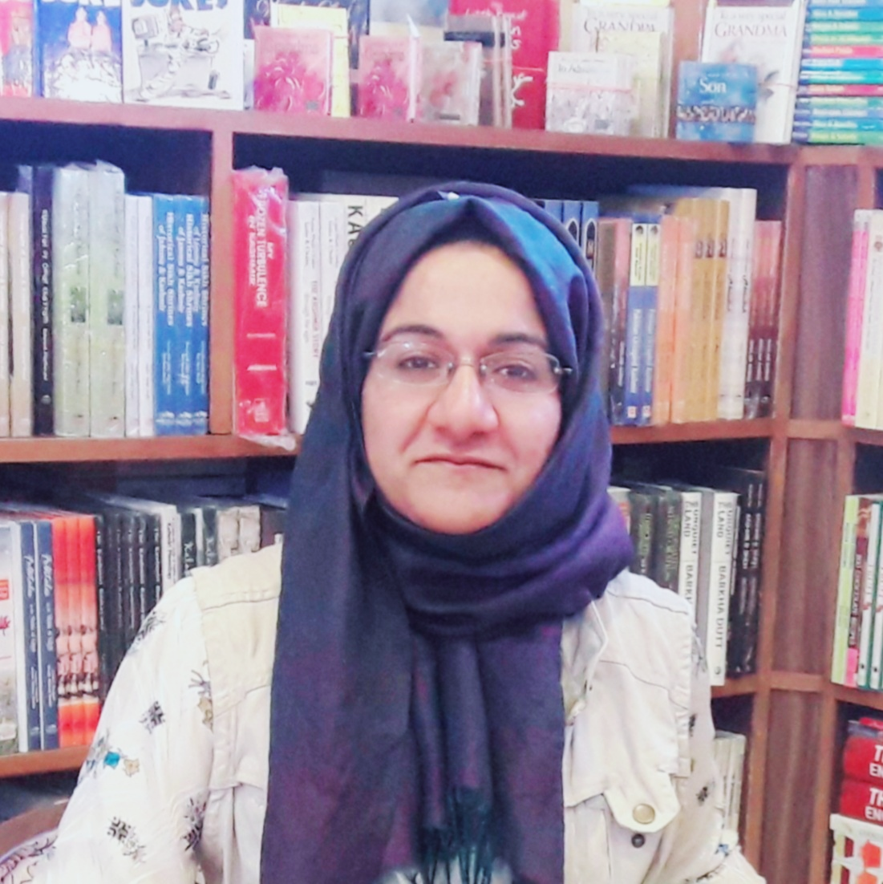
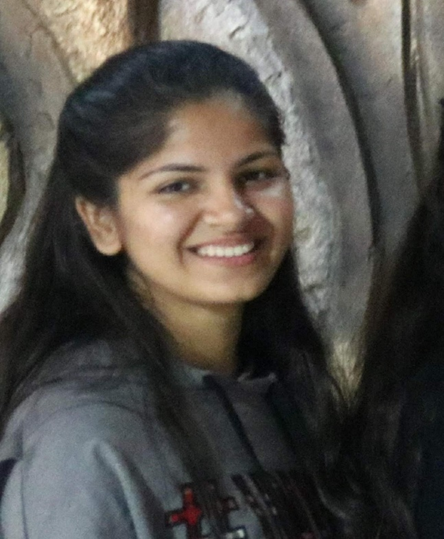
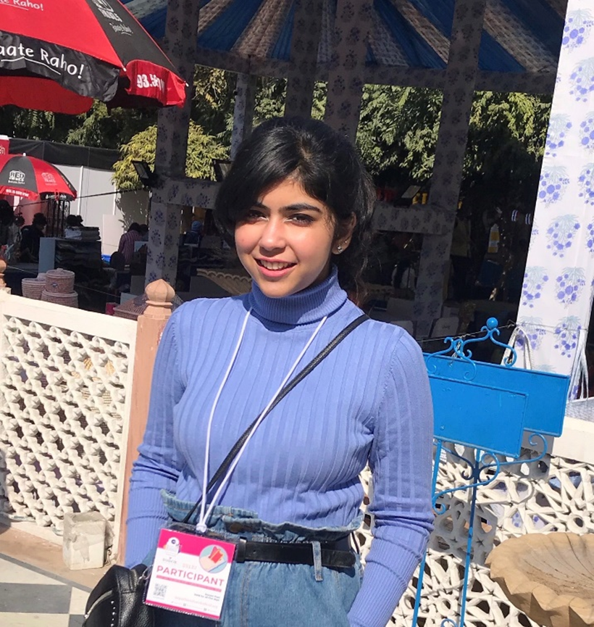

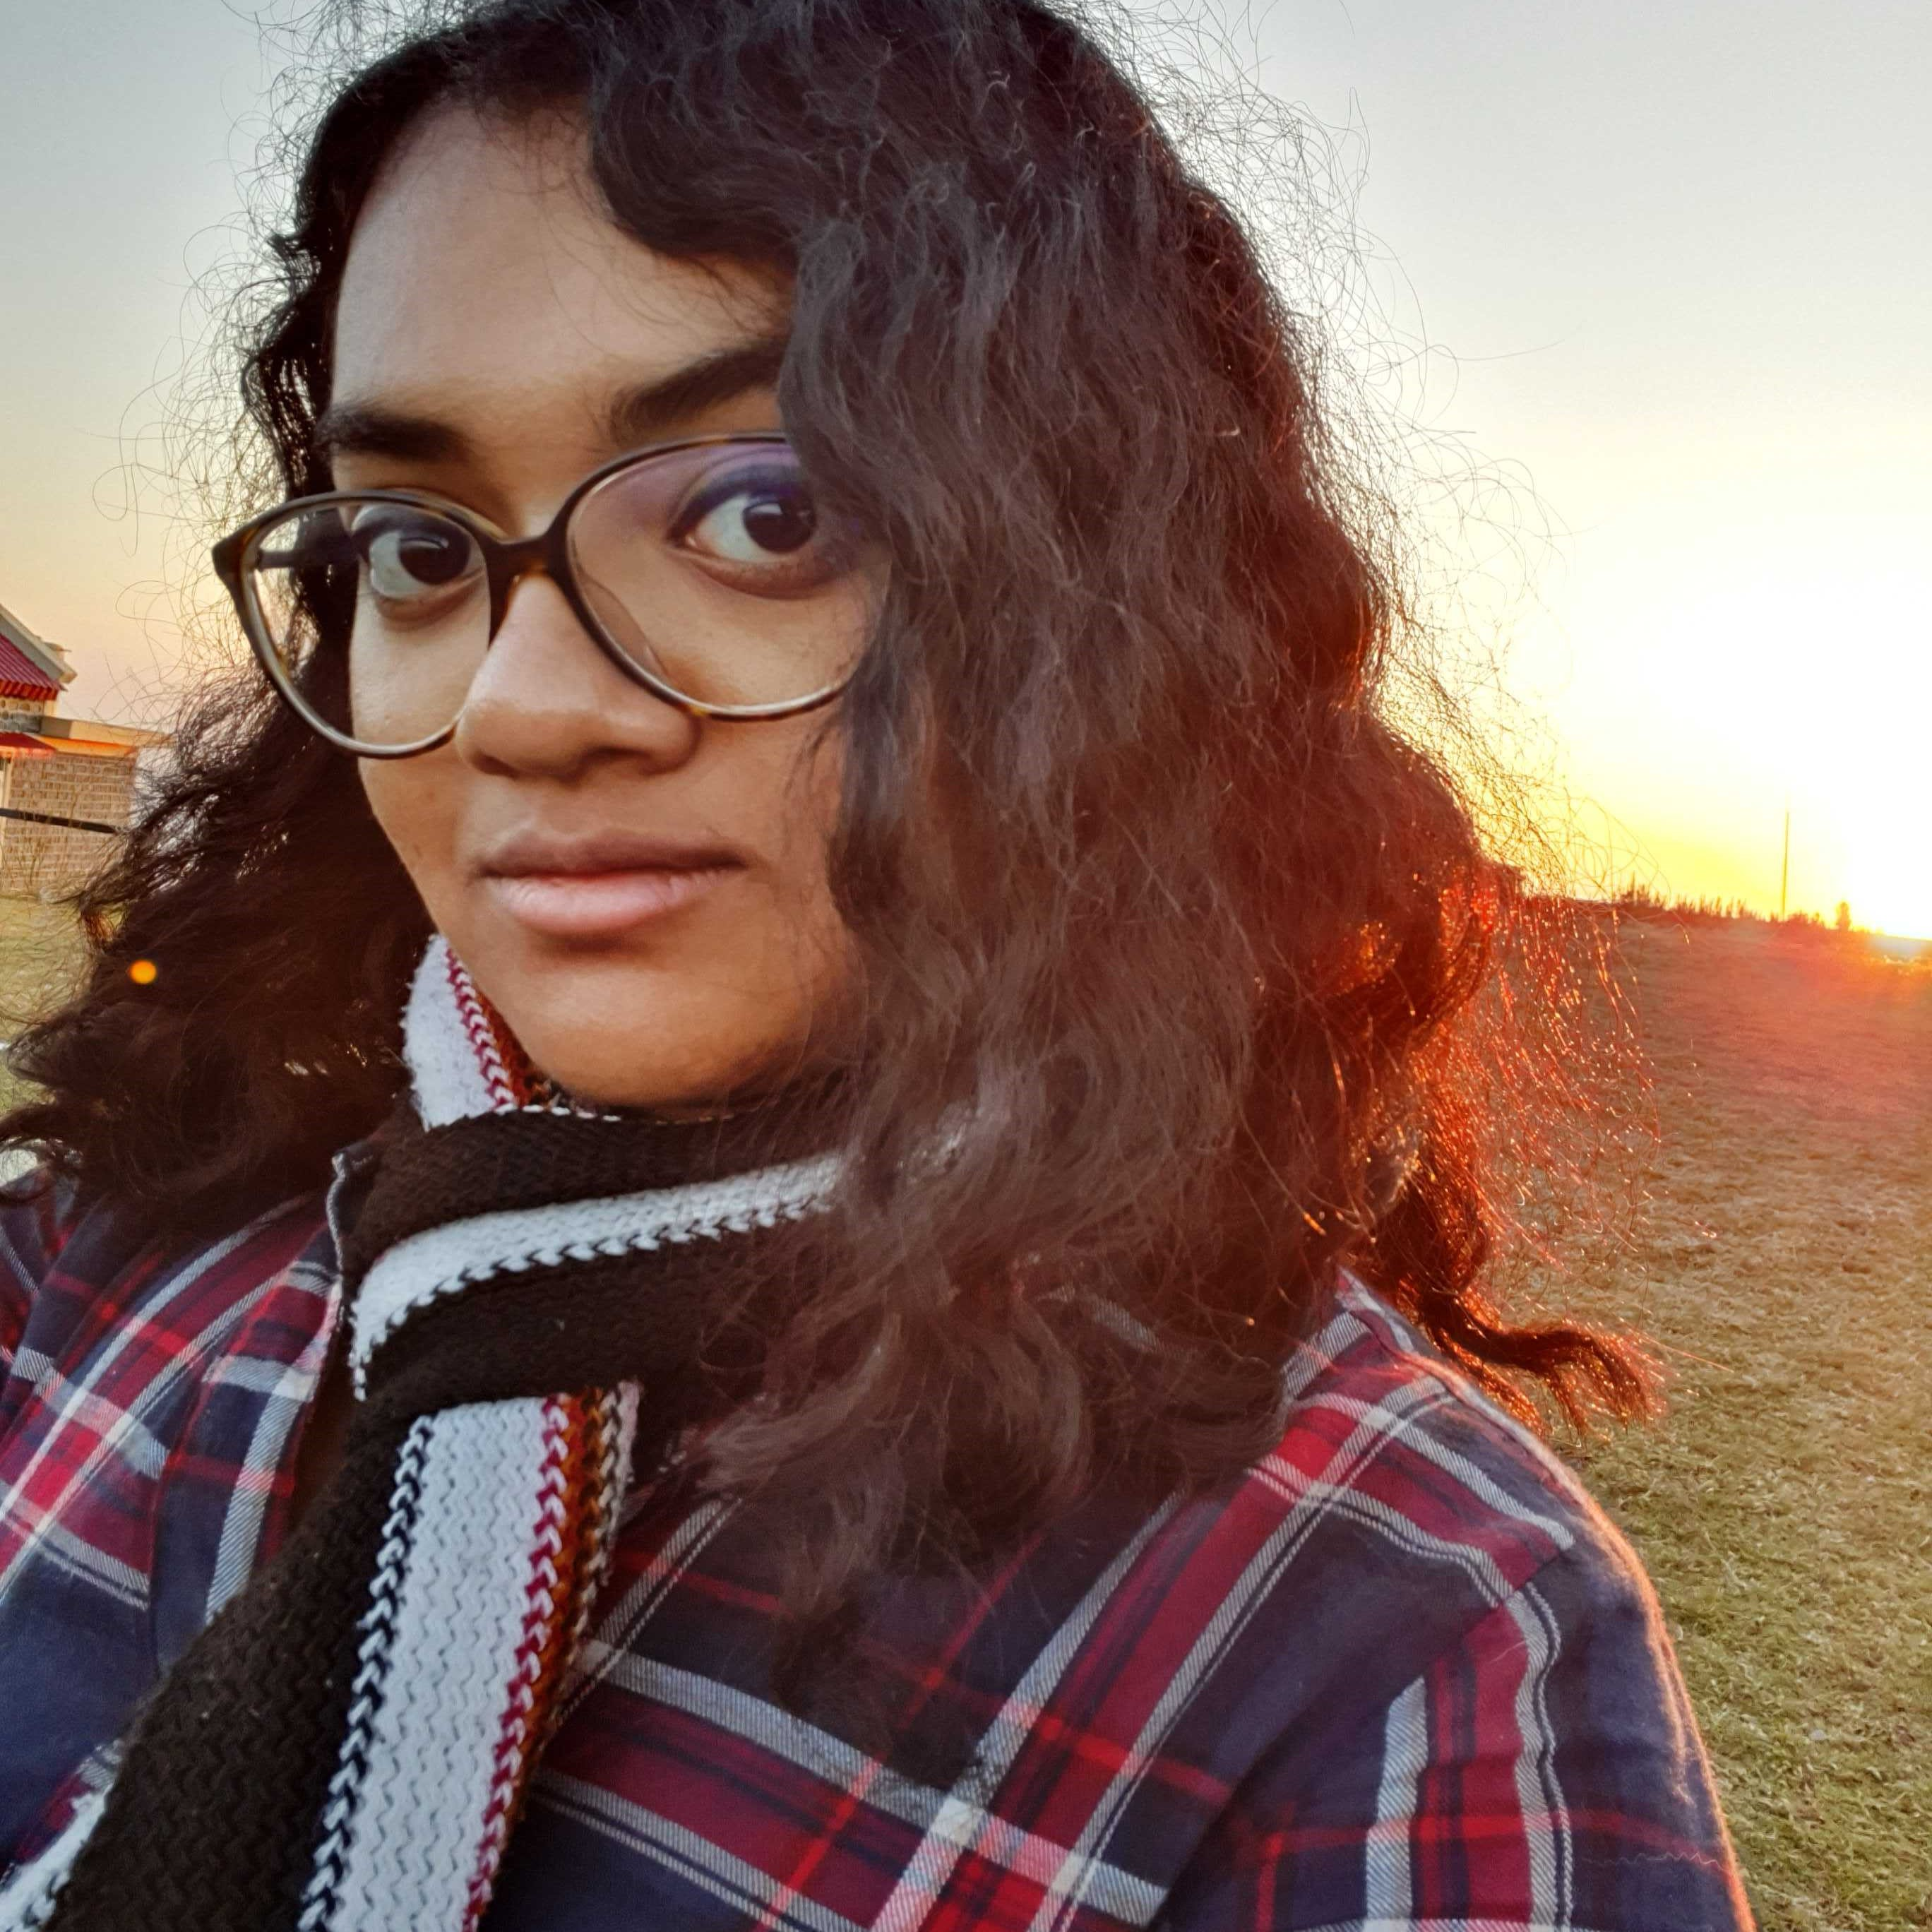
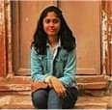
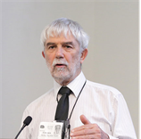
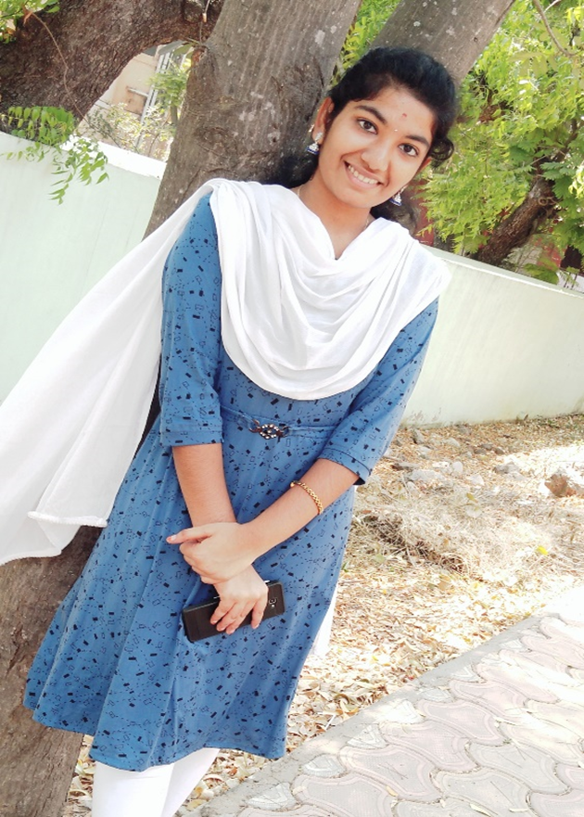
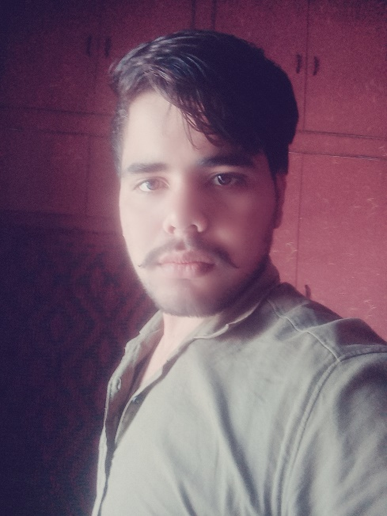
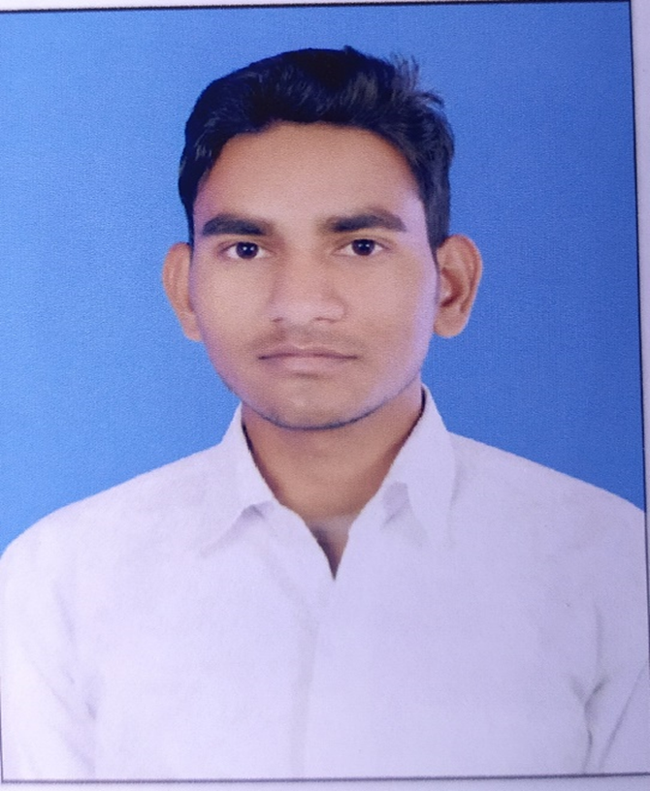
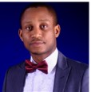
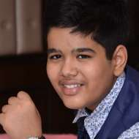
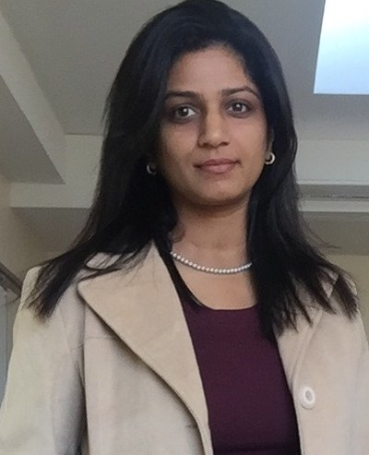
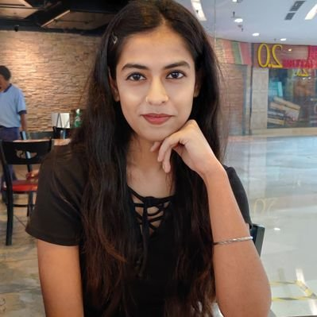
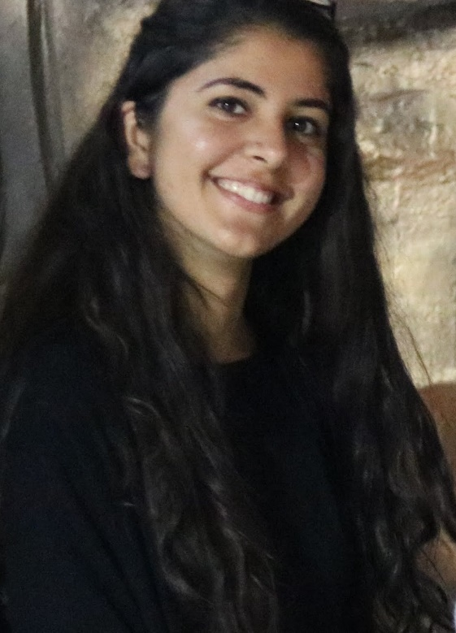
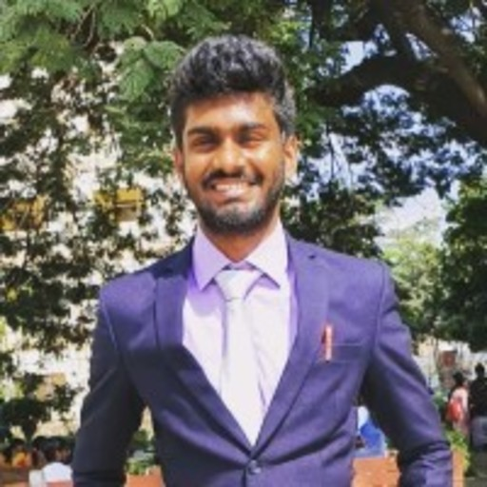
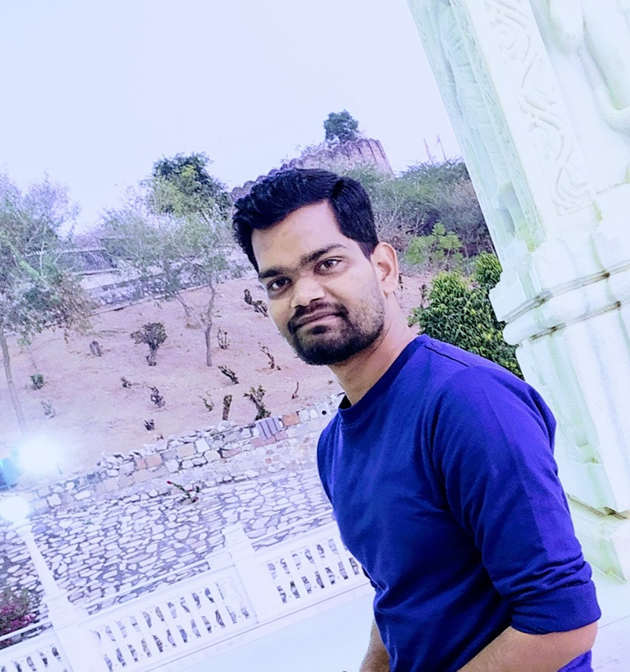
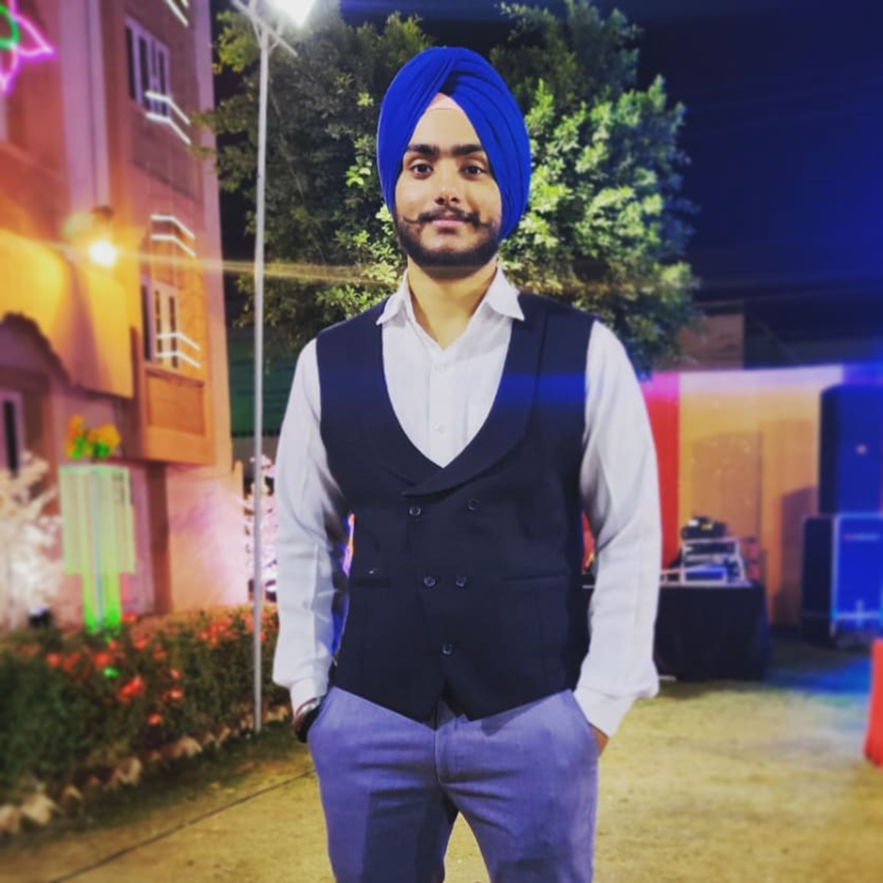
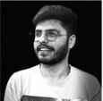
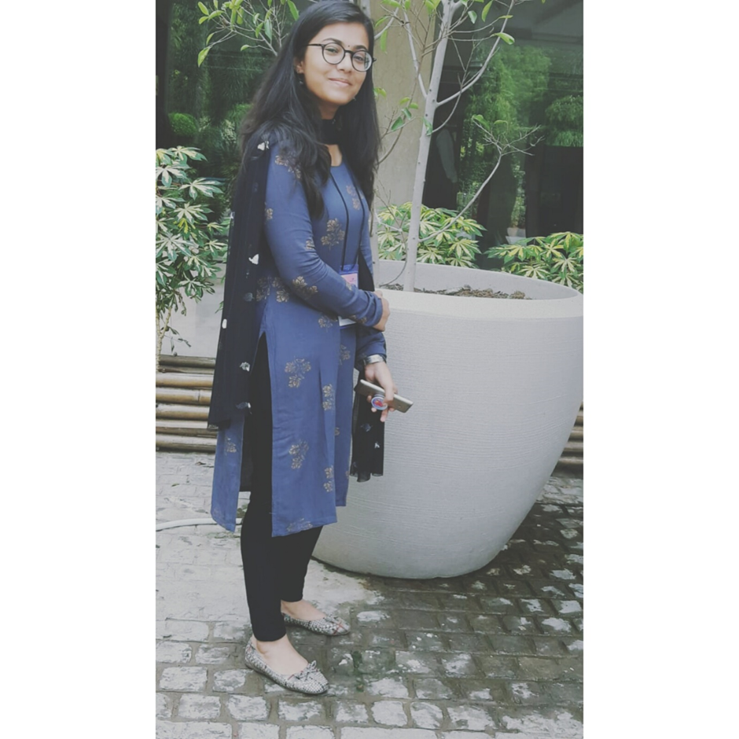
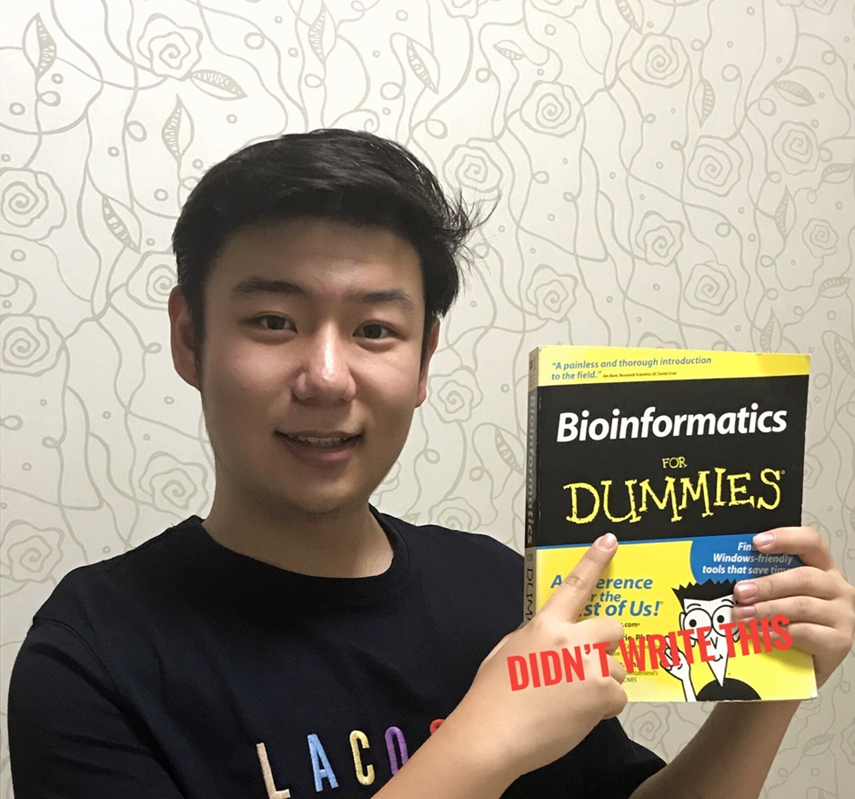
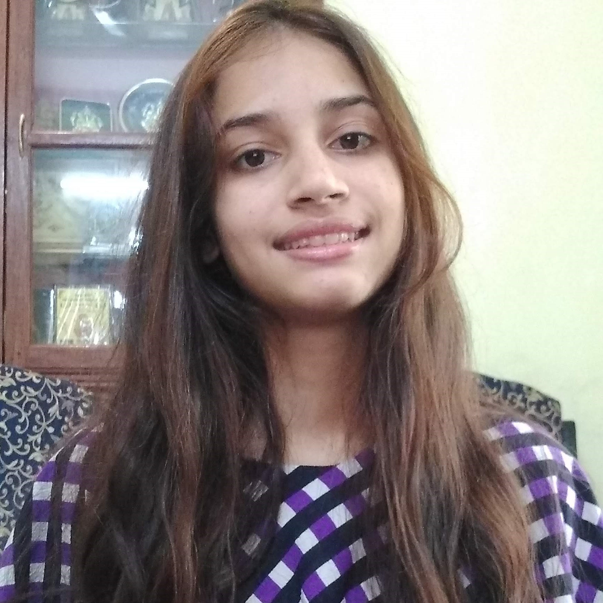
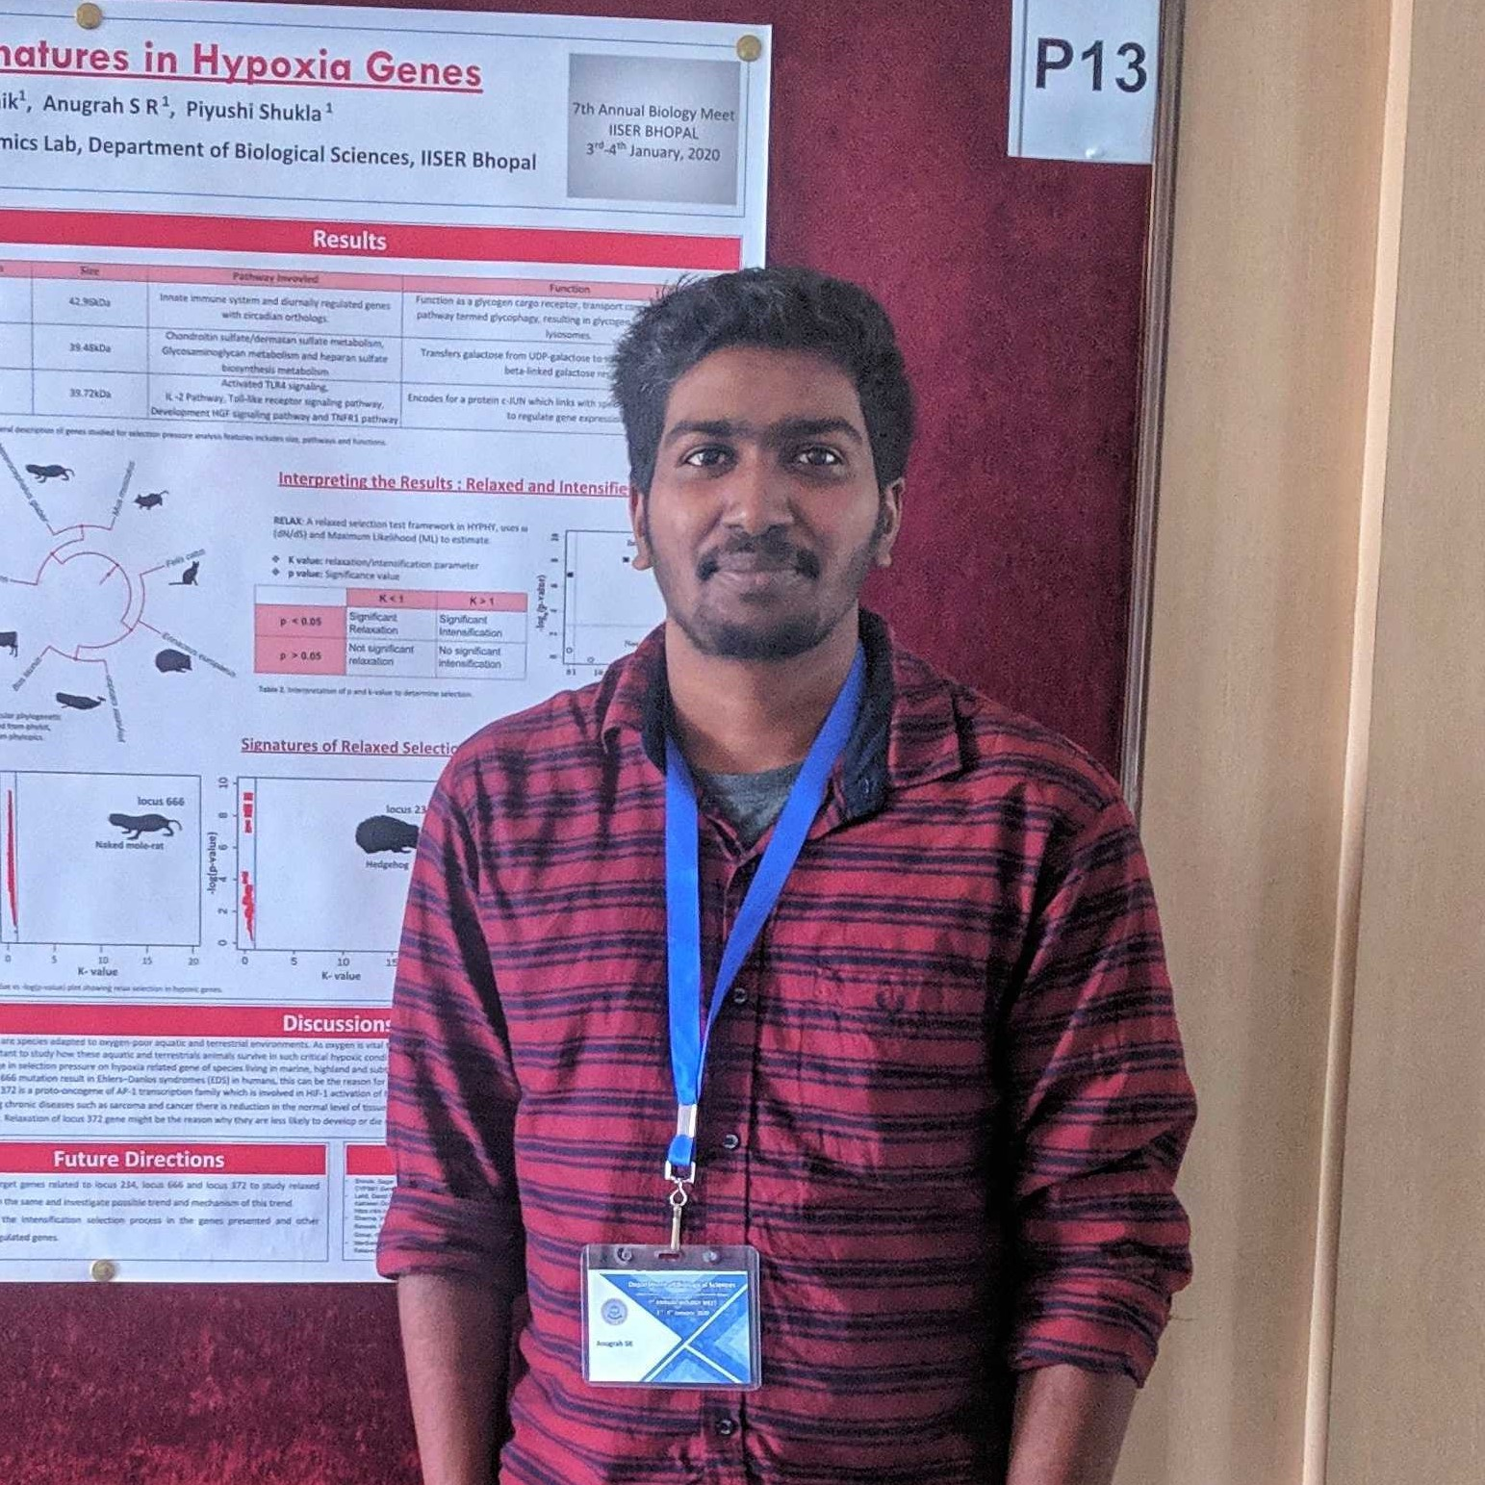
2020
INYAS KARYA Interns
CamBio Hackathon 2020
openVirus
NIPGR Interns
3 year rolling online internship program to tackle global challenges
Shweata is TIGR2ESS funded (2021)

Slide 6
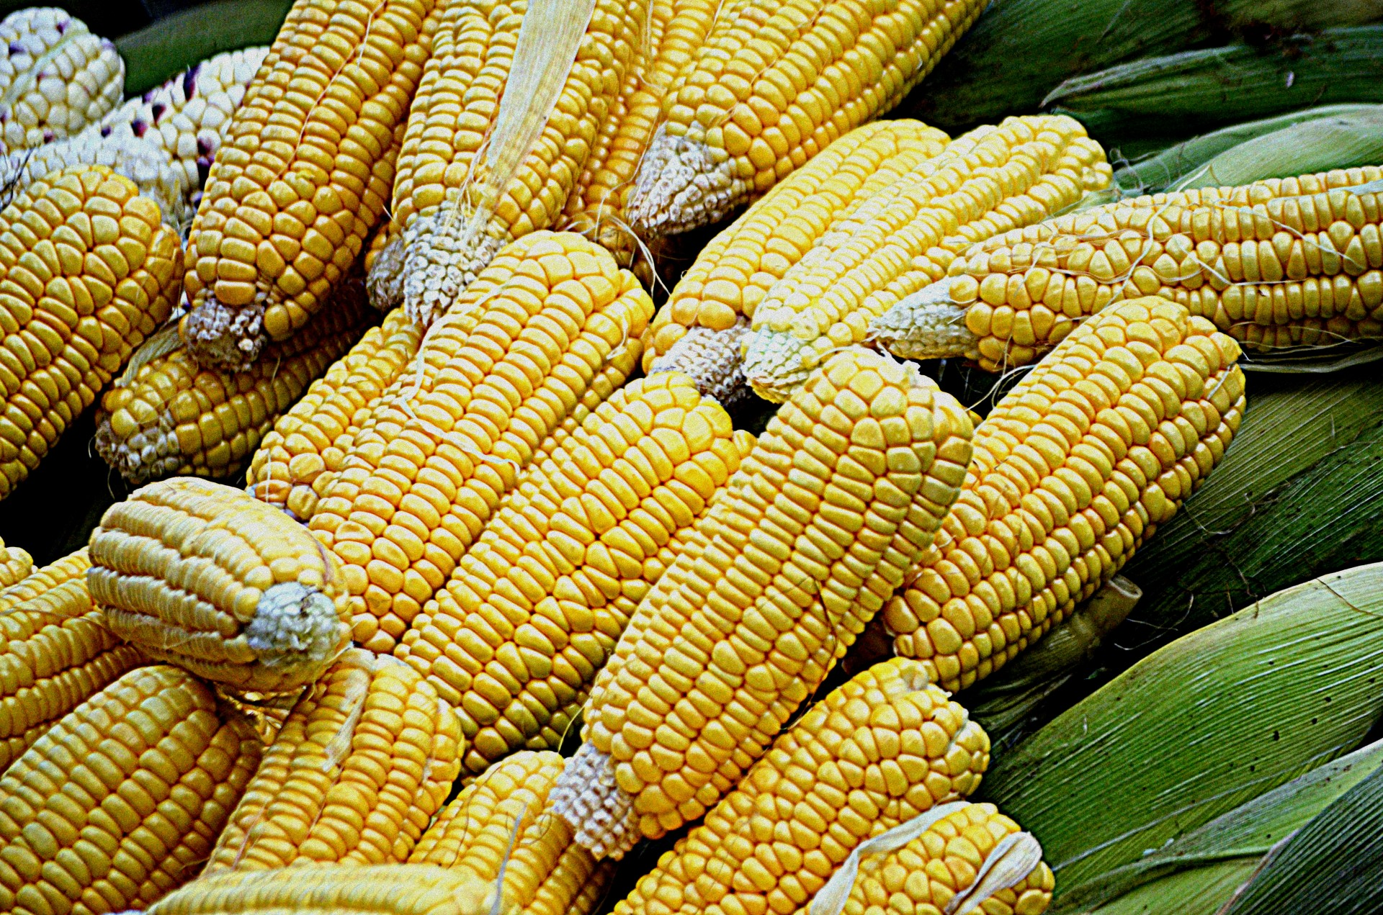
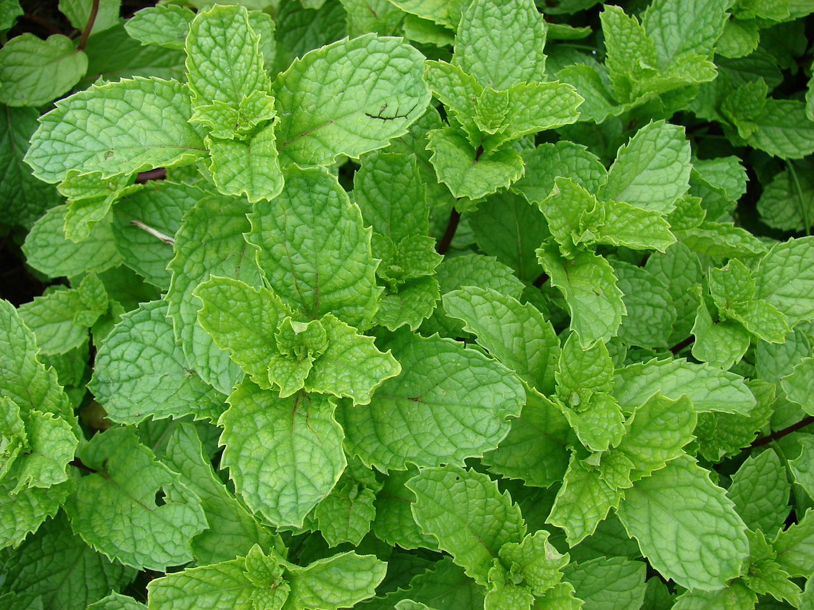
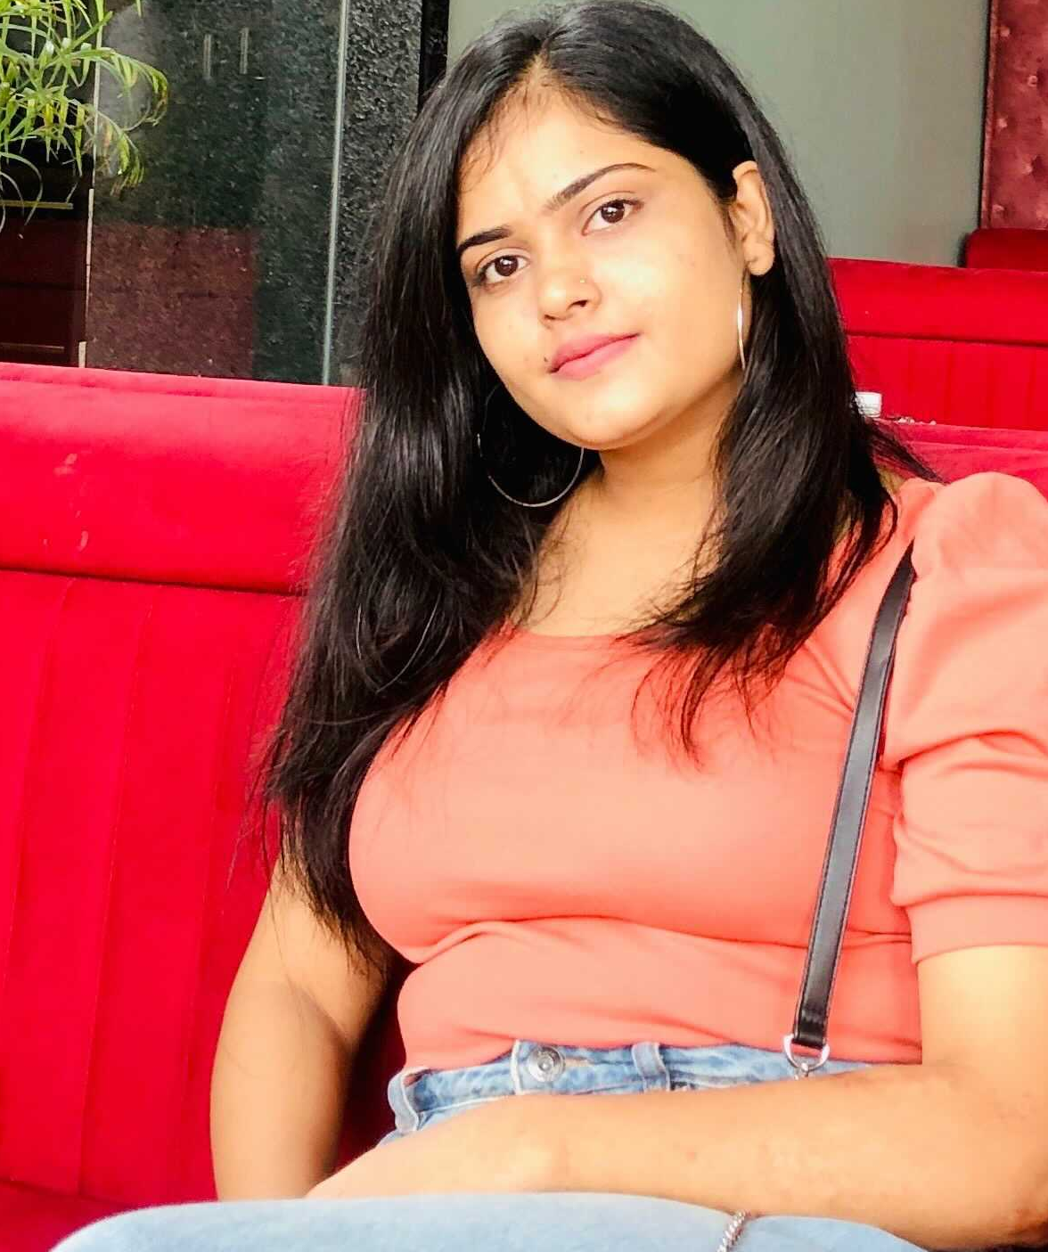
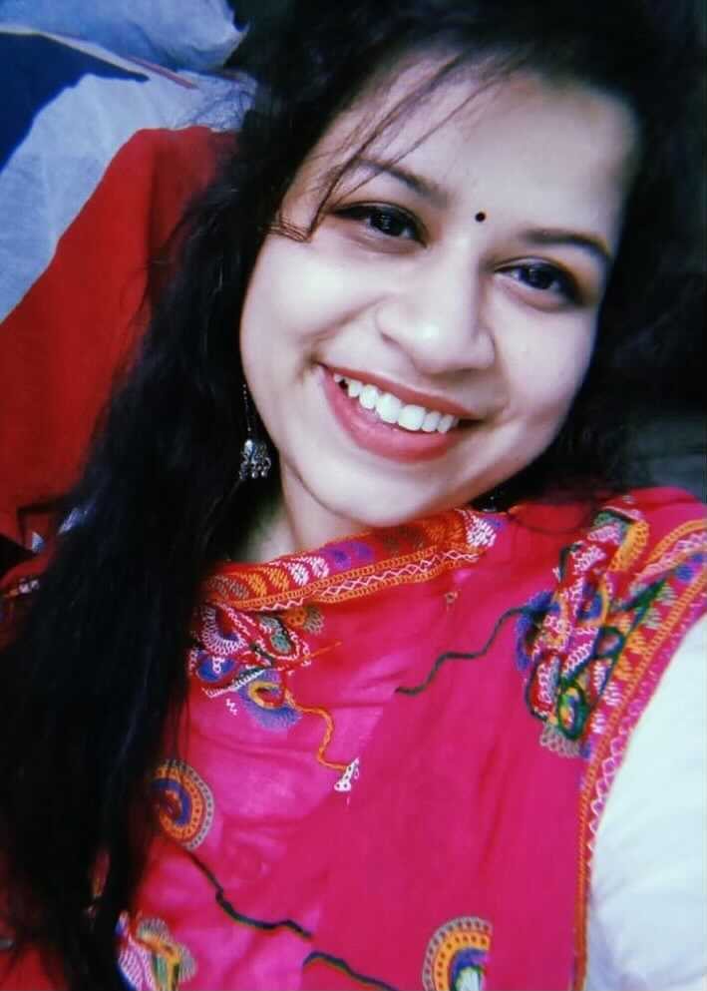
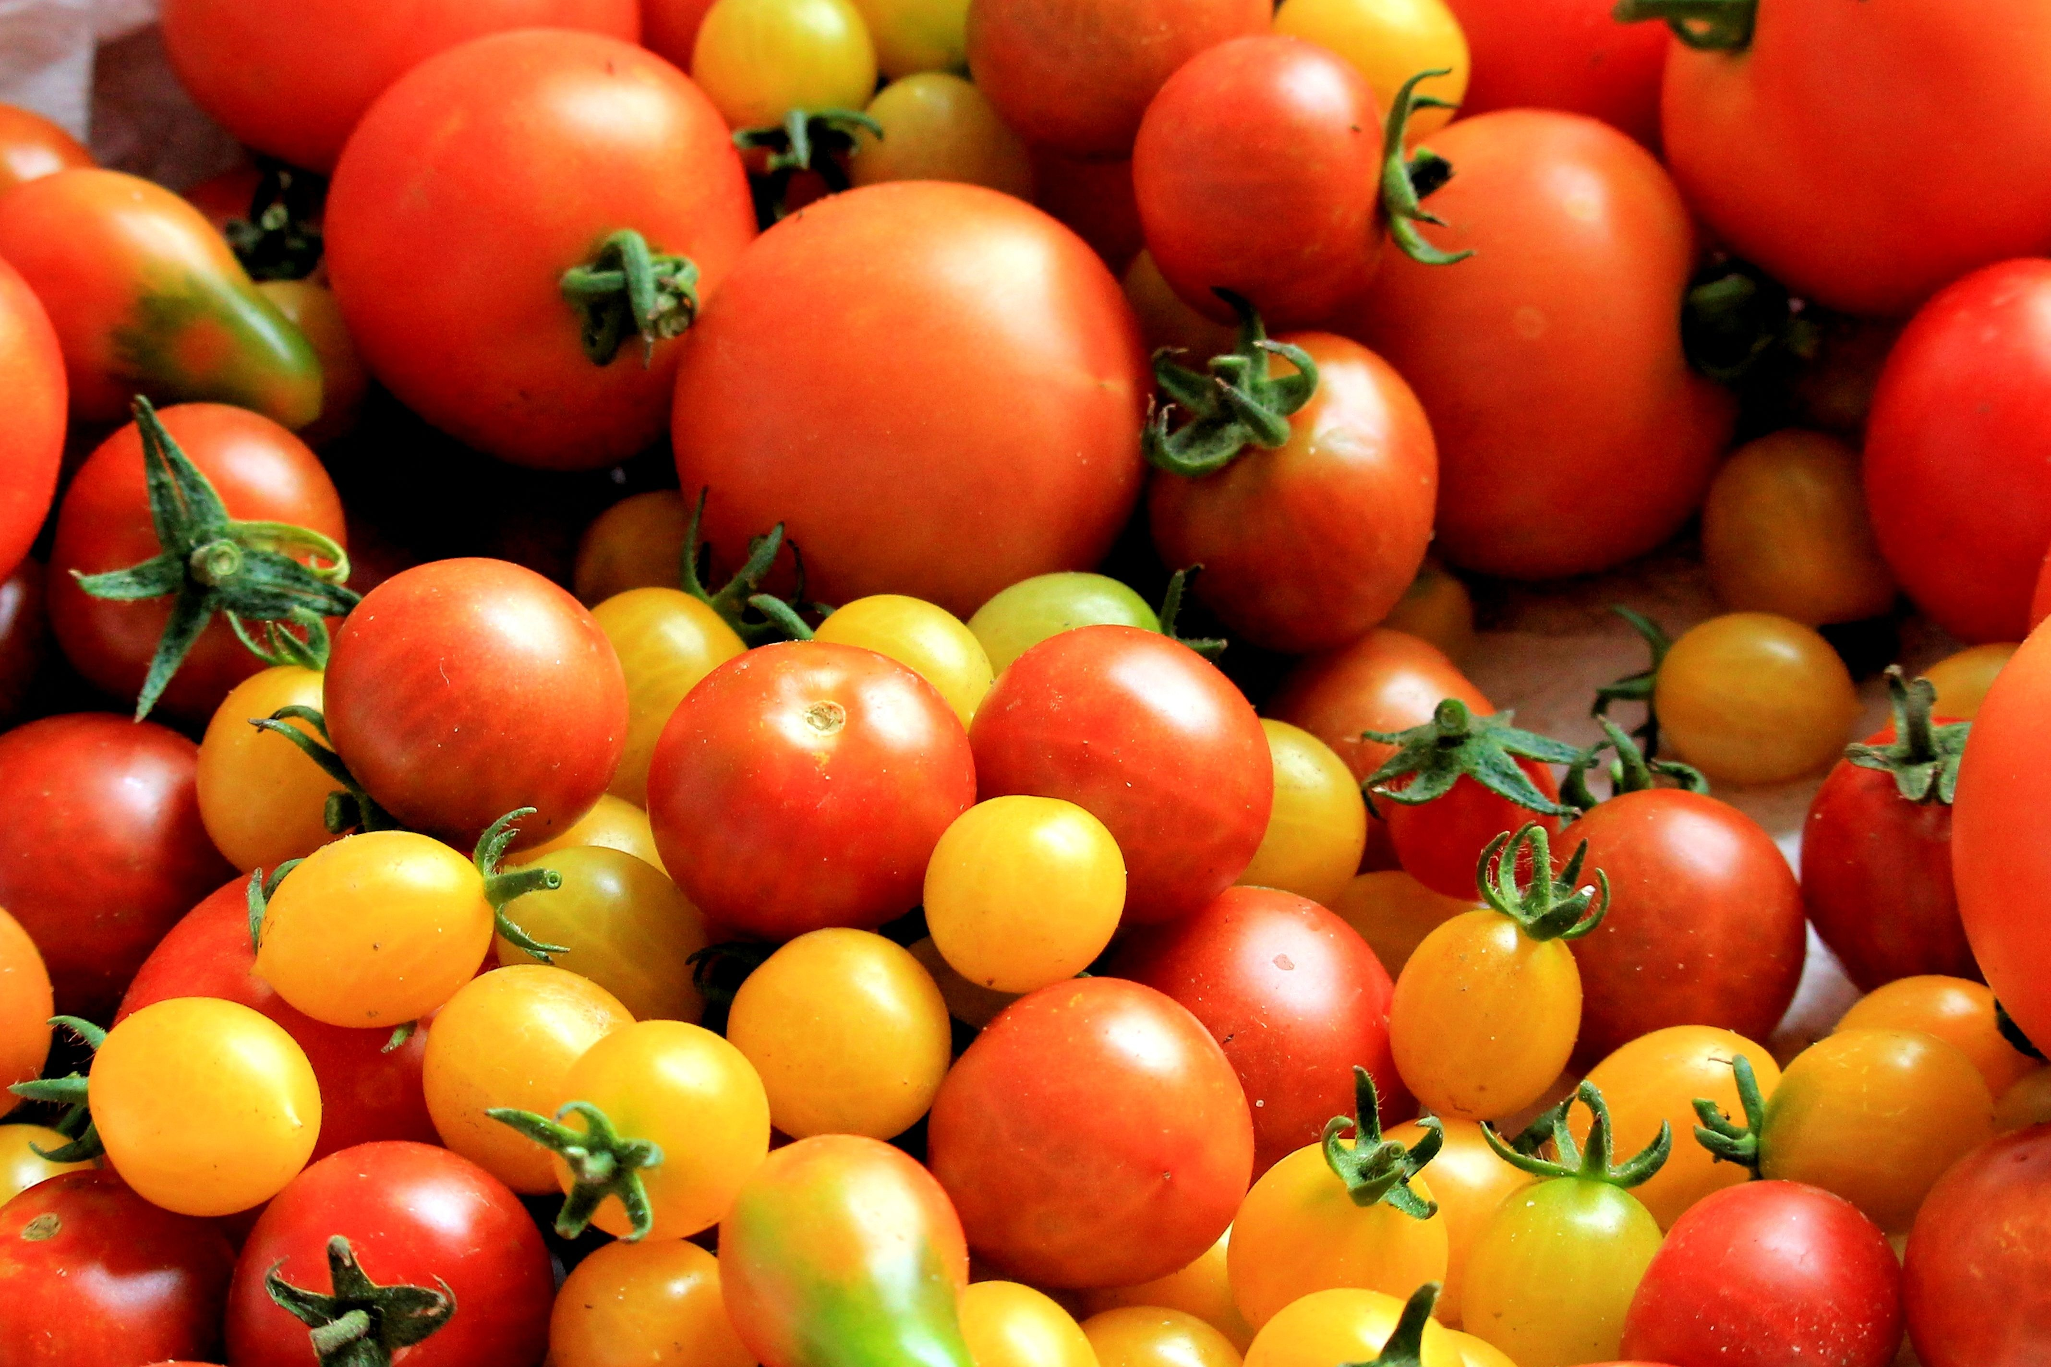
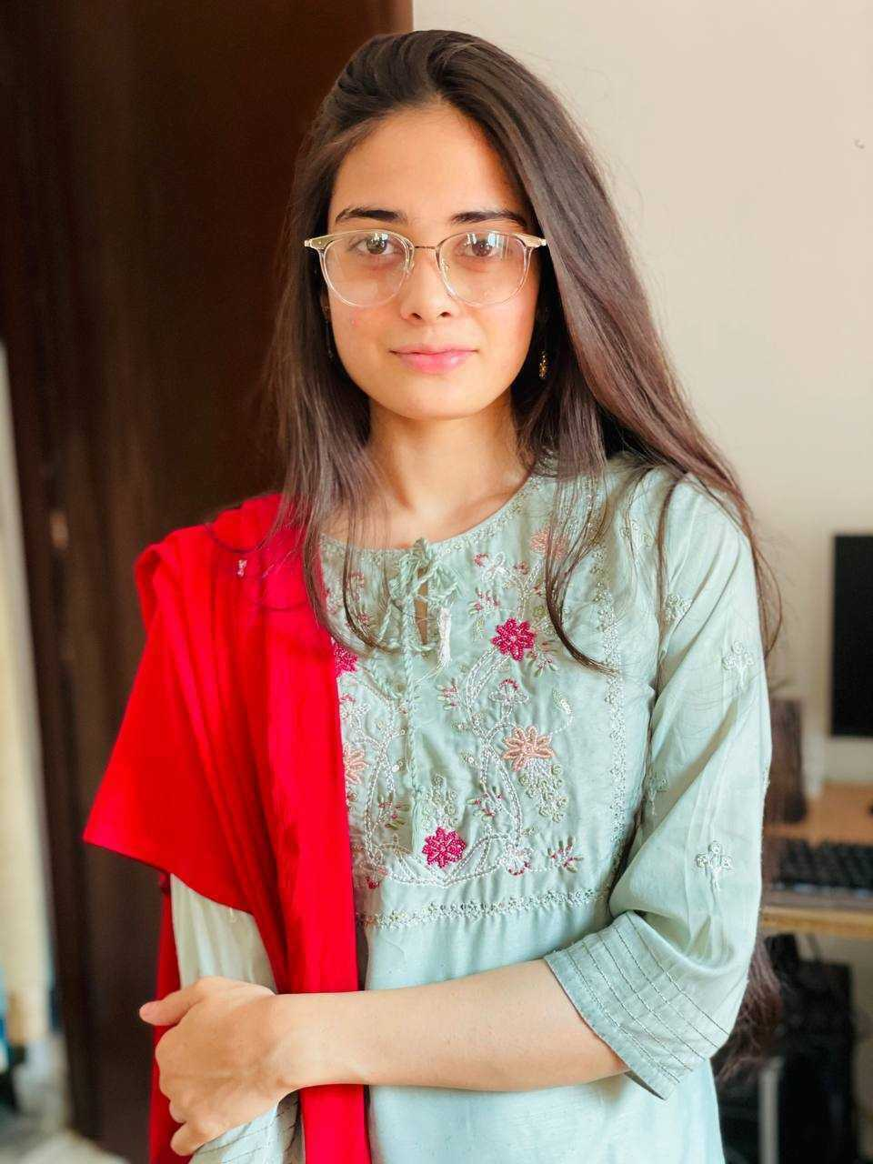
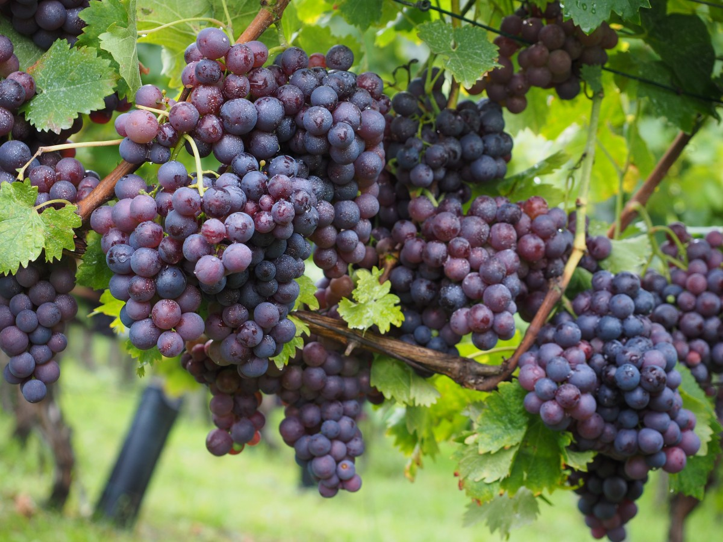
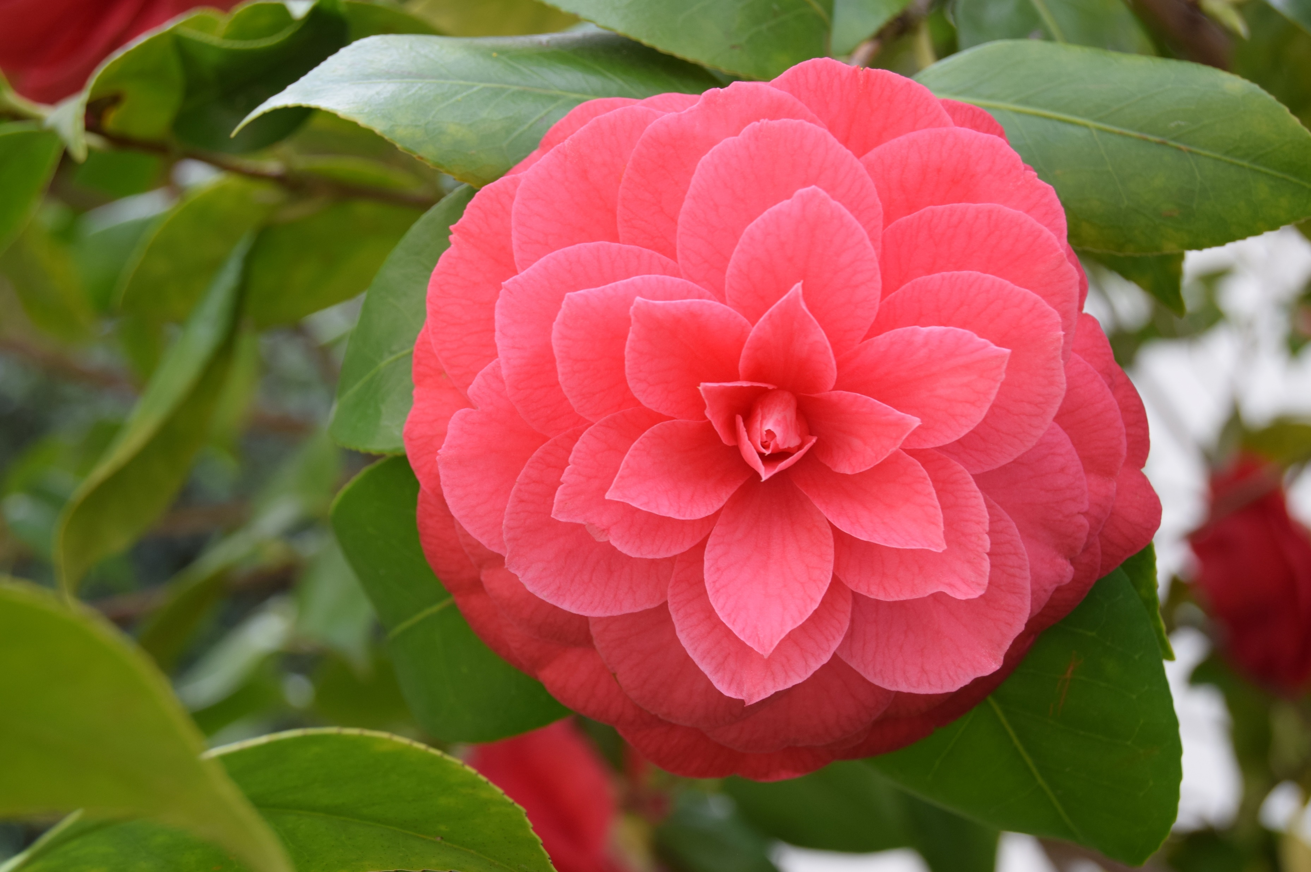
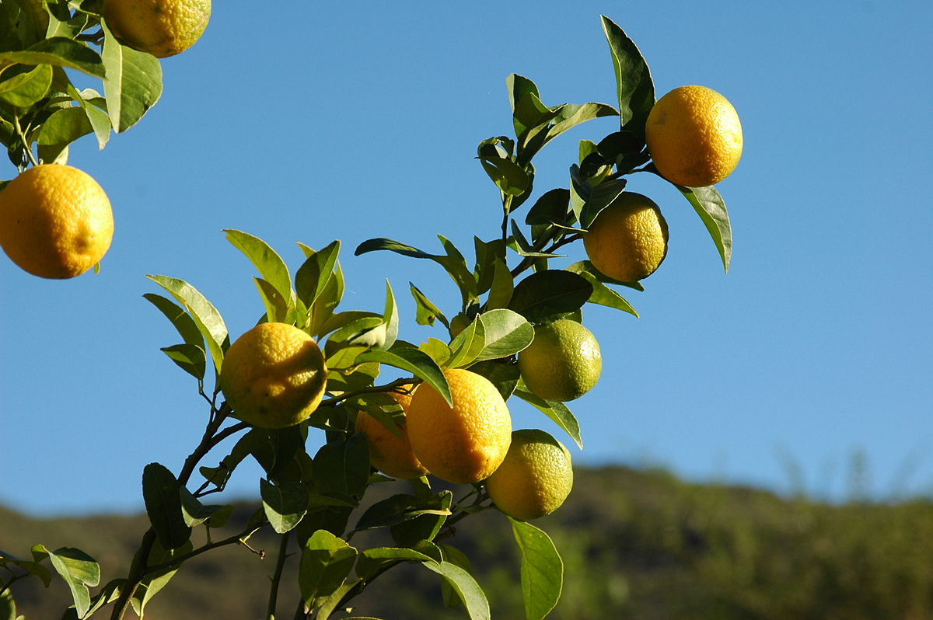

CORN
TOMATO
MINT
GRAPES
CAMELLIA
LEMON
Prachi Singh
Anam Anjum
Anjali Shekhawat
Kumari Rageshwari
Botany Undergrad, Janki Devi Bajaj Girls Govt. College, Kota
Masters (Botany) Student, Janki Devi Bajaj Government Girls Science College Kota
Masters (Botany) Student,
Jai Narain Vyas University,
Jodhpur, Rajasthan, India.
Masters (Biotech) Student,
Botany Department in University of Rajasthan
DBT-KARYA Interns 2021
https://en.wikipedia.org/wiki/Terpene_synthase_N_terminal_domain , CC BY-SA
This Photo by Unknown Author is licensed under CC BY-SA
Notes:
Condense to 4-5

Slide 7
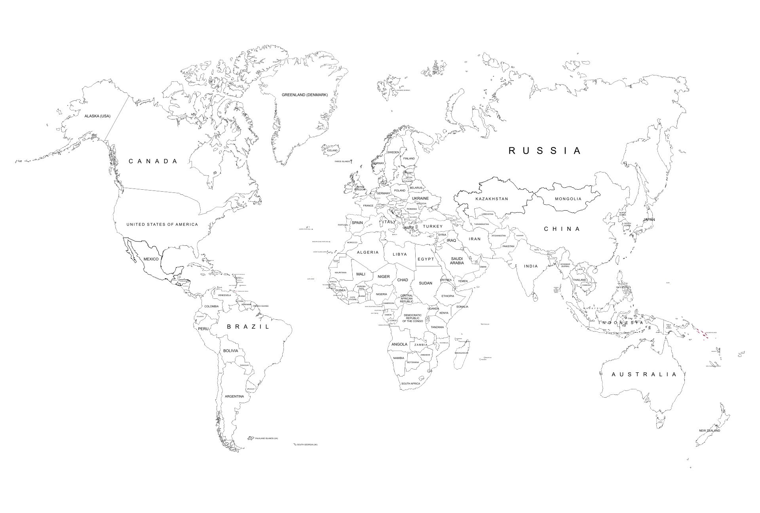
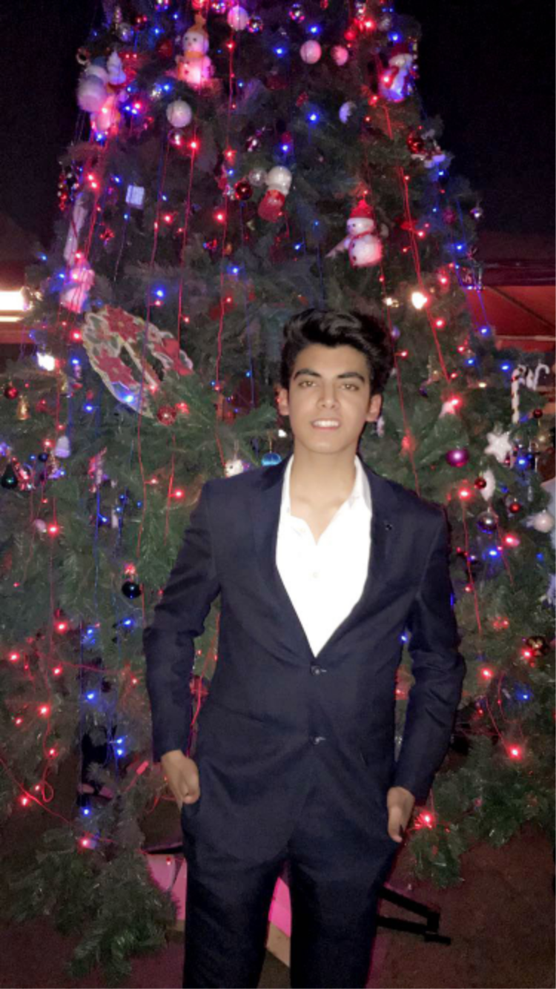
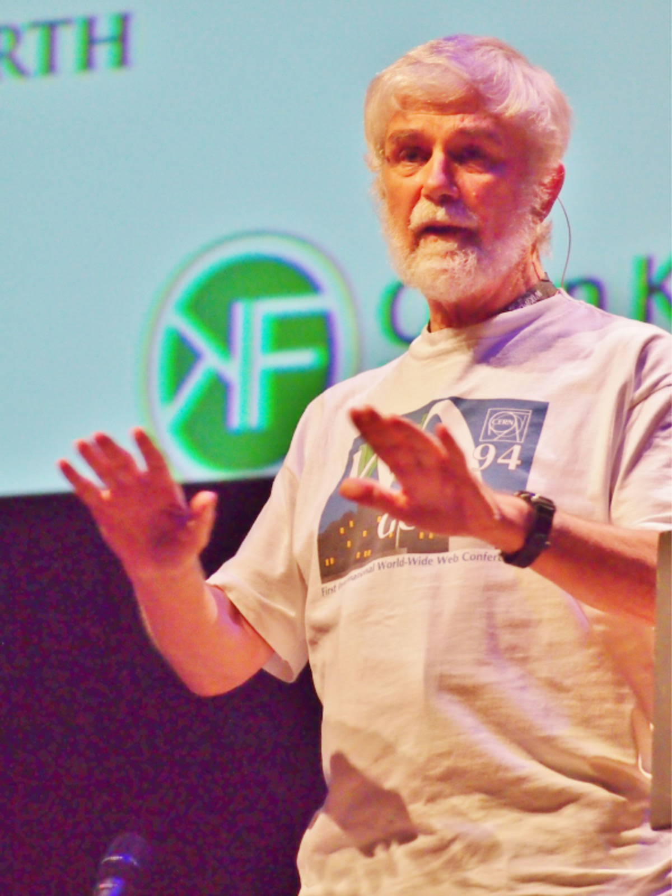

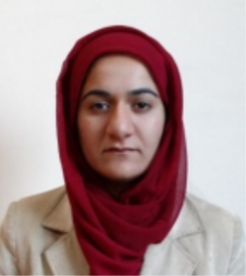
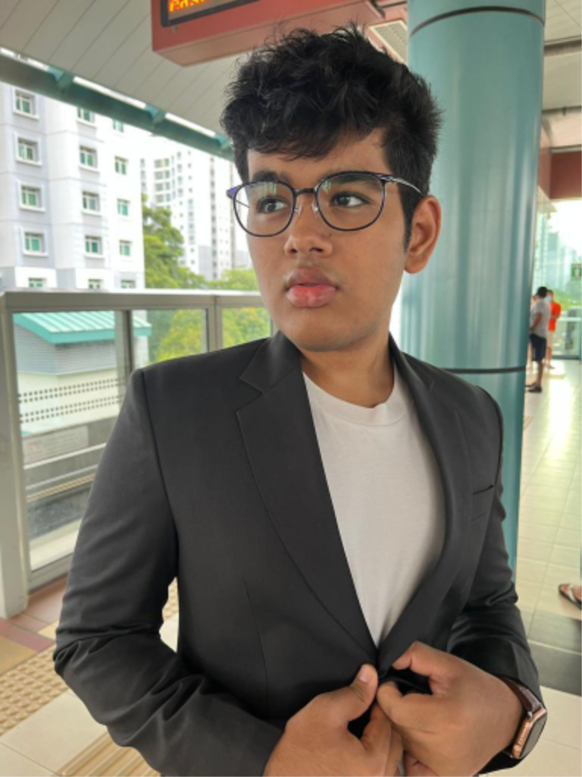
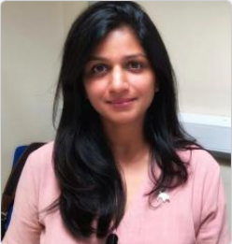
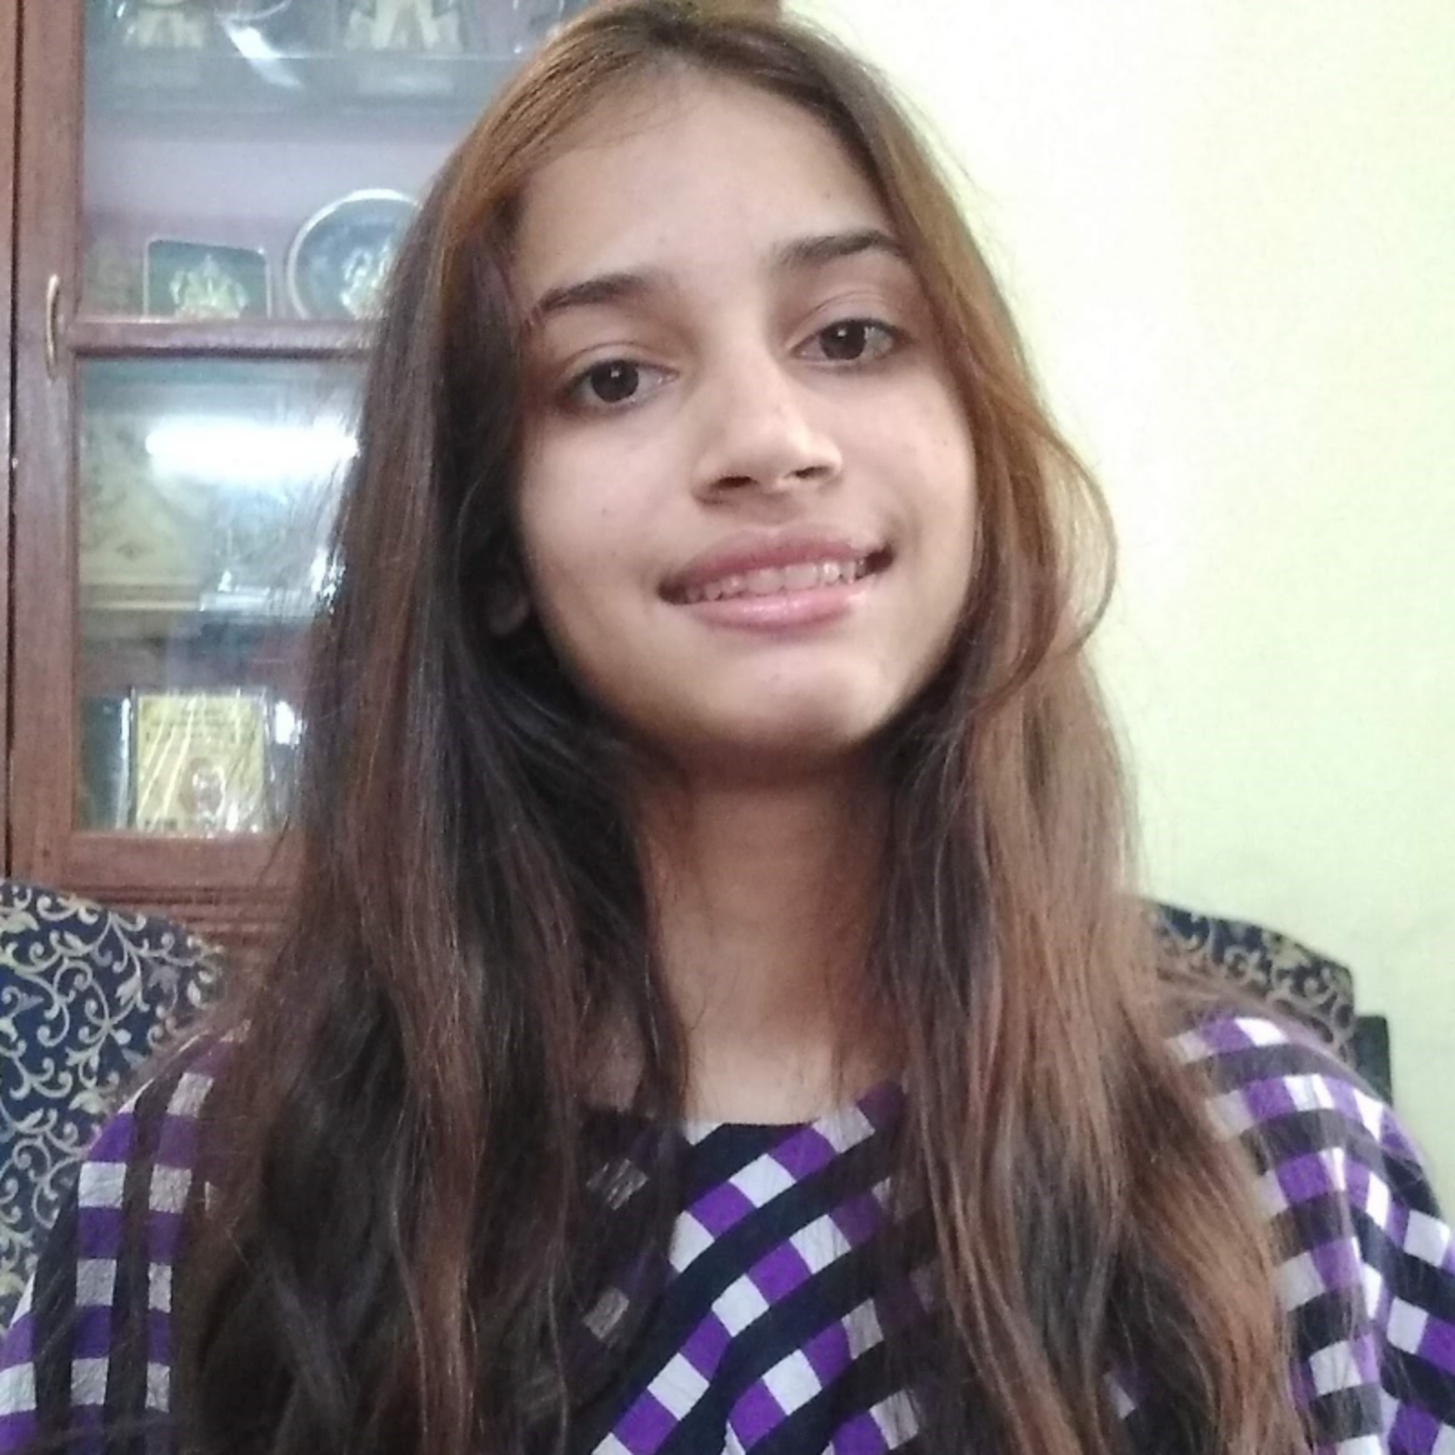
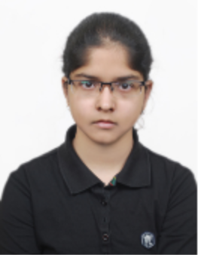
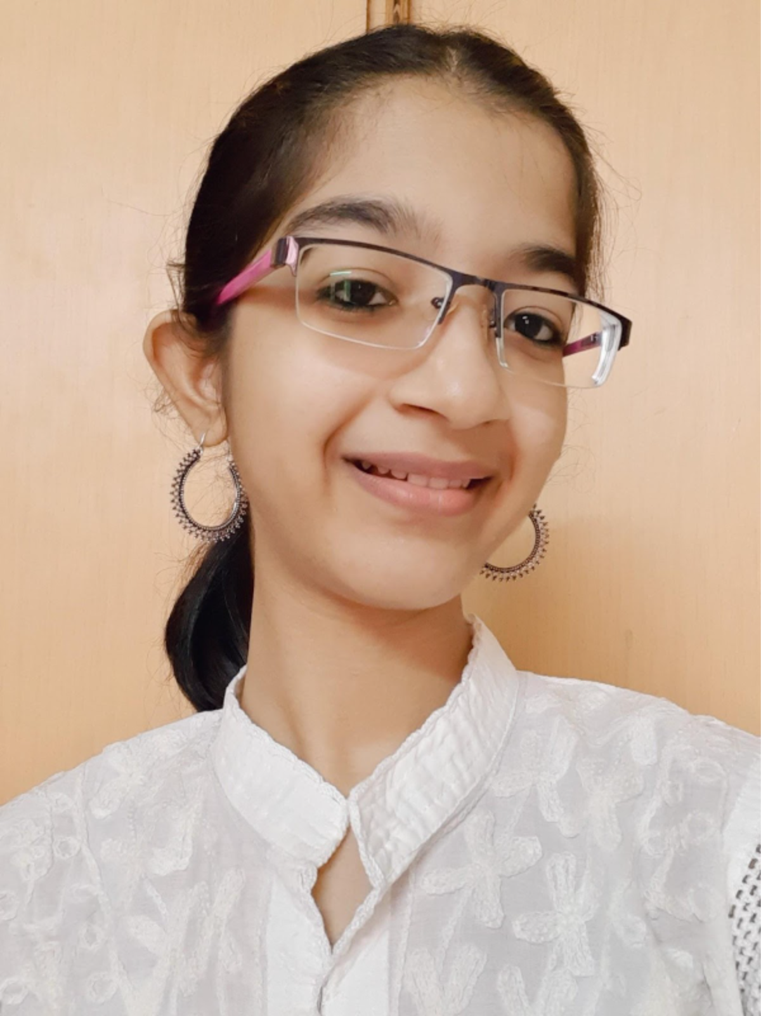
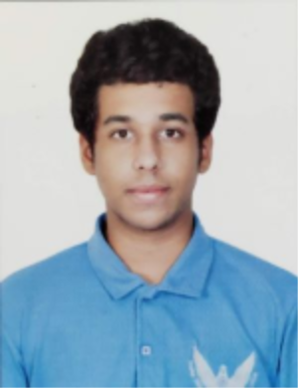
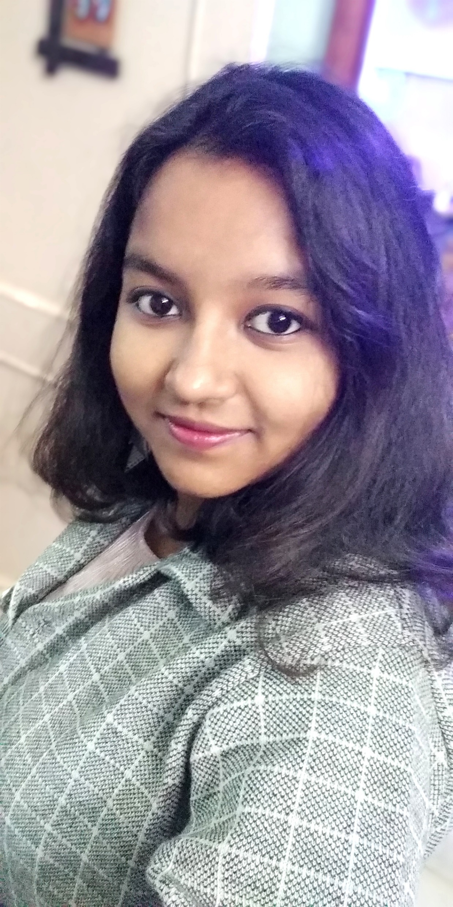
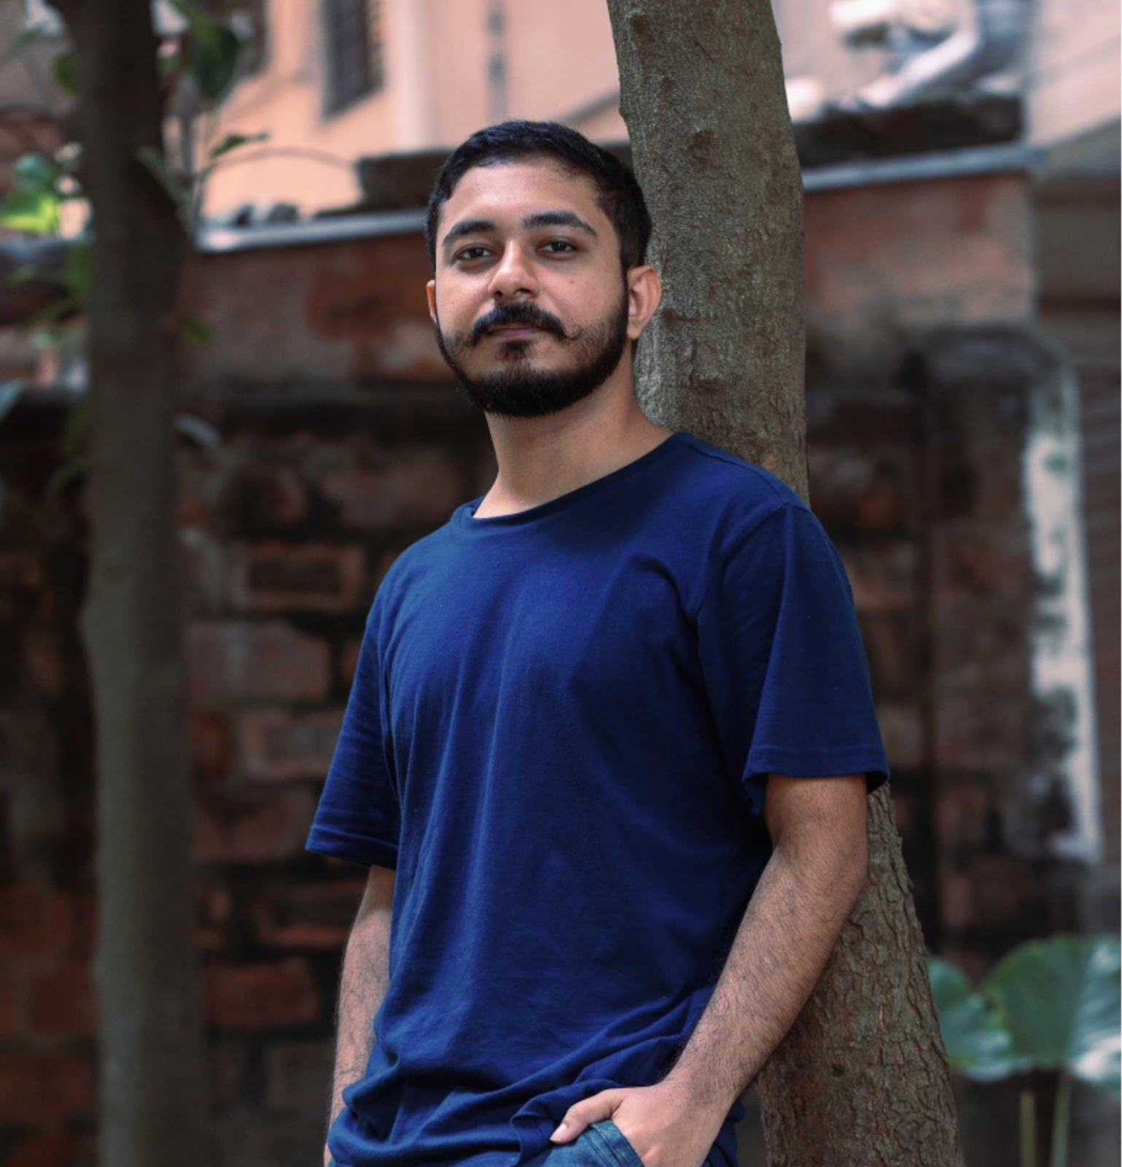
Semantic Climate -- 2022
Slide credit: Enakshi Das

Slide 8

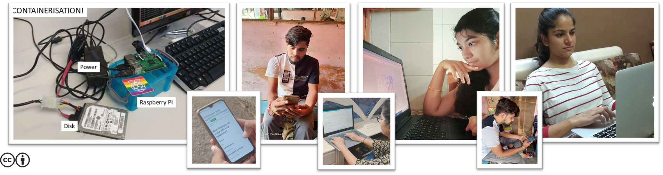
Use tech!
Python
Slide Credit: Ambreen Hamadani
This Photo by Unknown Author is licensed under CC BY-SA
This Photo by Unknown Author is licensed under CC BY-SA

Slide 9



Collaborate…
Updated 19-hours ago
real-time updates!
GitHub
Open Notebook Philosophy*
Try it!
https://github.com/petermr/CEVOpen
https://github.com/petermr/pygetpapers
https://github.com/petermr/pyami
Everything on the web!
*https://en.wikipedia.org/wiki/Open-notebook_science
This Photo by Unknown Author is licensed under CC BY

Slide 10










Work as community
People
Not-started
What I Did?
What I Plan to Do?
Blocks?
In-progress
Tasks
Completed
Daily Catch-up
This Photo by Unknown Author is licensed under CC BY-ND

Slide 11


Future
Young people developing tech and collaborations for global challenges
Cambiohack, 2020
Piaget Hackathon, SDG, 2022
Notes:
Traffic Lights -> Spreadsheet + literal traffic light
Daily Stand-ups
What I did
What next
Blockers
Community
Icons > Textual information

